Slide 1

Presmeal

Slide 2
Food delivery order from student to student

Slide 3

Do you realize that 30 minutes of rest time between classes on campus is not enough to buy food around campus?
therefore food delivery services are very important among students.

Slide 4


but did you guys realize that the price is at another food delivery application turns out different from the original price plus more with shipping costs, of course this becomes the reason many students choose to starve.
app price = original price + 20%

Slide 5

Presmeal comes with a price offer real and affordable shipping.
Batch system
with a Presmeal’s system batch can be petrified you eat on time and have nothing to fear with expensive prices such as food delivery other.

Slide 6


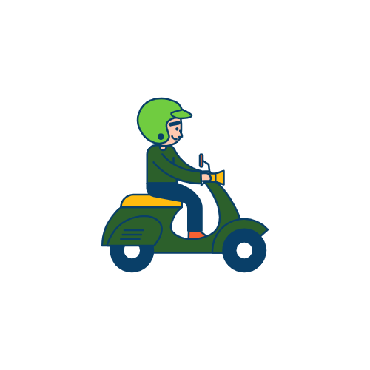

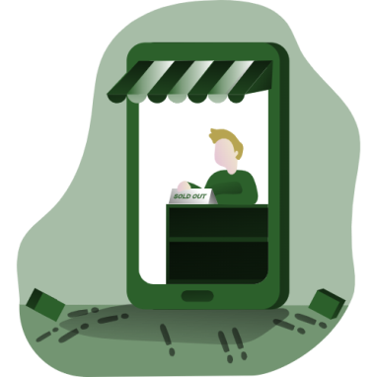

Batch system
Collecting
Driver
User
booth
Restaurant
Meal time

Slide 7

Batch system
With our batch system, users also easily prepare
their breakfasts, lunches better.
So that when it's time
for you to take a break,
you just have to take food without bothering, waiting for orders, let alone queuing yourself.

Slide 8
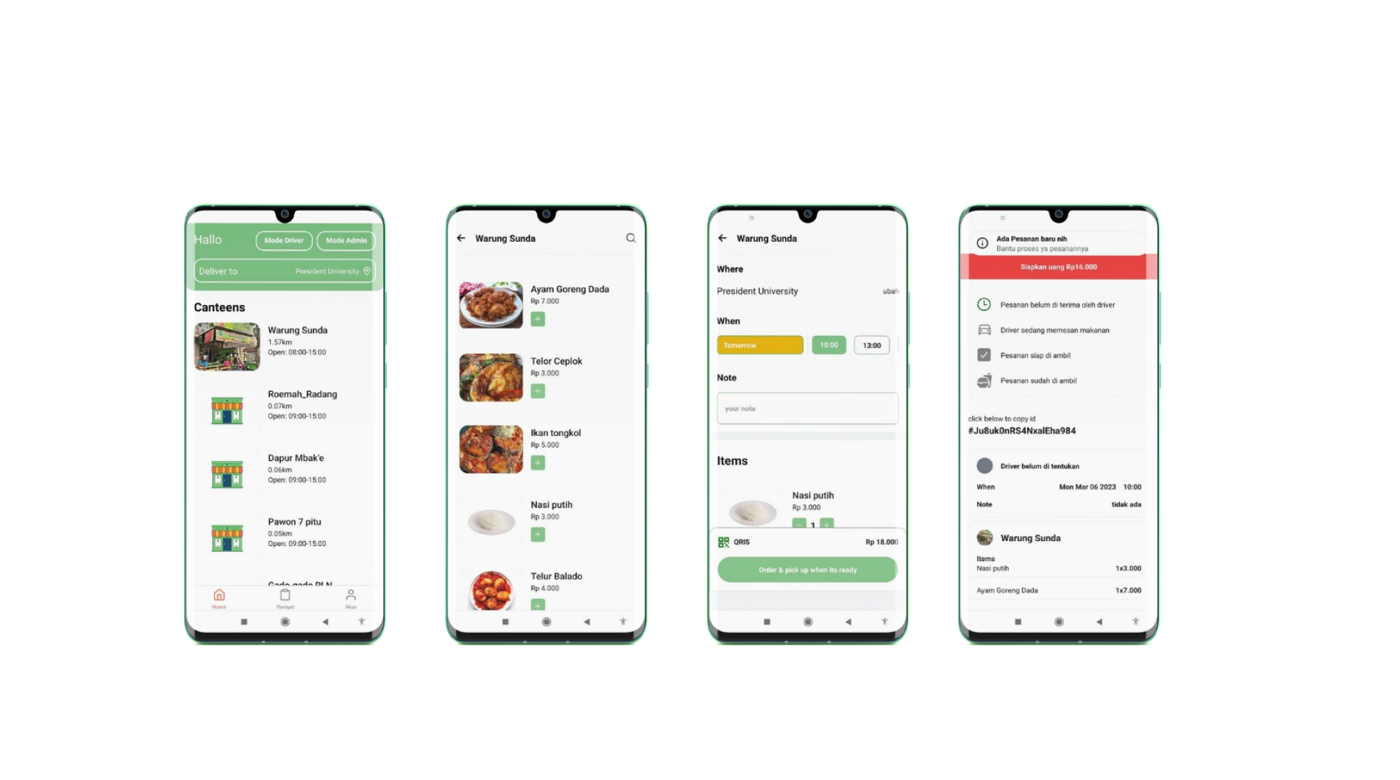

Our Product
Presmeal has a simple and easy to use UI.
now you can access our app at Playstore

Slide 9
Our Team
CEO
Wardana
CTO
Erlangga
COO
Rayhan maulana
CMO
Aditiya
CFO
Dustin

